Slide 1
CIS 4517/5517: Data Intensive and Cloud Computing Finding similar items: part 2
Dr. Xubin He
Computer and Information Sciences
Temple University

Slide 2
Credit:
Most slides are adapted from: http://www.mmds.org
Mining of Massive Datasets, by Jure Leskovec, Anand Rajaraman, Jeff Ullman
Read Chapter 3 of “Mining of Massive Datasets” at http://www.mmds.org

Slide 3
Distance Measures
Goal: Find near-neighbors in high-dim. space
We formally define “near neighbors” as points that are a “small distance” apart
For each application, we first need to define what “distance” means
Today: Jaccard distance/similarity
The Jaccard similarity of two sets is the size of their intersection divided by the size of their union: sim(C₁, C₂) = |C₁∩C₂|/|C₁∪C₂|
Jaccard distance: d(C₁, C₂) = 1 - |C₁∩C₂|/|C₁∪C₂|
3 in intersection
8 in union
Jaccard similarity= 3/8
Jaccard distance = 5/8

Slide 4
3 Essential Steps for Similar Docs
Shingling: Convert documents to sets
Min-Hashing: Convert large sets to short signatures, while preserving similarity
Locality-Sensitive Hashing: Focus on pairs of signatures likely to be from similar documents
Candidate pairs!

Slide 5
Define: Shingles
A k-shingle (or k-gram) for a document is a sequence of k tokens that appears in the doc
Tokens can be characters, words or something else, depending on the application
Assume tokens = characters for examples
Example: k=2; document D₁ = abcab Set of 2-shingles: S(D₁) = {ab, bc, ca}

Slide 6
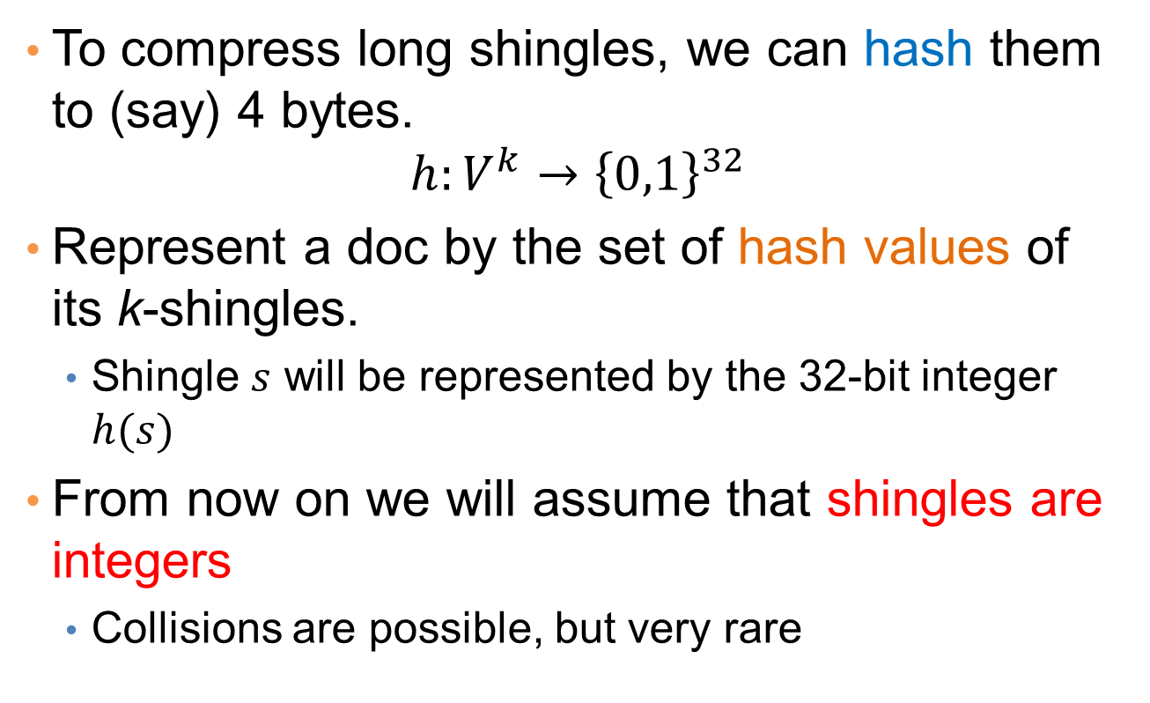
Shingles: Compression Option
To compress long shingles, we can hash them to (say) 4 bytes.
$$h:V^{k}→{\left\{0,1\right\}}^{32}$$
Represent a doc by the set of hash values of its k-shingles.
Shingle $s$ will be represented by the 32-bit integer $h(s)$
From now on we will assume that shingles are integers
Collisions are possible, but very rare

Slide 7
Encoding Sets as Bit Vectors
Encode sets using 0/1 (bit, boolean) vectors
One dimension per element in the universal set
Interpret set intersection as bitwise AND, and set union as bitwise OR
Example: C₁ = 10111; C₂ = 10011
Size of intersection = 3; size of union = 4,
Jaccard similarity (not distance) = 3/4
Distance: d(C₁,C₂) = 1 – (Jaccard similarity) = 1/4

Slide 8
From Sets to Boolean Matrices
Rows = elements (shingles)
Columns = sets (documents)
1 in row e and column s if and only if e is a member of s
Column similarity is the Jaccard similarity of the corresponding sets (rows with value 1)
Typical matrix is sparse!
Each document is a column:
Example: sim(C₁ ,C₂) = ?
Size of intersection = 3; size of union = 6, Jaccard similarity (not distance) = 3/6
d(C₁,C₂) = 1 – (Jaccard similarity) = 3/6
Documents
1
1
1
0
1
1
0
1
0
1
0
1
Characteristic Matrix
0
0
0
1
Shingles
1
0
0
1
1
1
1
0
1
0
1
0

Slide 9
Outline: Finding Similar Columns
So far:
Documents → Sets of shingles
Represent sets as boolean vectors in a matrix
Problem: Documents could be too big (long columns)
Next goal: Find similar columns while computing small signatures
Similarity of columns == similarity of signatures

Slide 10
Hashing Columns (Signatures)
Key idea: “hash” each column C to a small signature h(C), such that:
(1) h(C) is small enough that the signature fits in RAM
(2) sim(C₁, C₂) is the same as the “similarity” of signatures h(C₁) and h(C₂)
Goal: Find a hash function h(·) such that:
If sim(C₁,C₂) is high, then with high prob. h(C₁) = h(C₂)
If sim(C₁,C₂) is low, then with high prob. h(C₁) ≠ h(C₂)
There is a suitable hash function for the Jaccard similarity: It is called Min-Hashing

Slide 11
Min-Hashing
Pick a random permutation of the rows (the universe U).
Define “hash” function for set S
h(S) = the index of the first row (in the permuted order) in which column S has 1.
or
h(S) = the index of the first element of S in the permuted order.
Use k (e.g., k = 100) independent random permutations to create a signature.

Slide 12
Example of minhash signatures
Input matrix
 | S₁ | S₂ | S₃ | S₄
A | 1 | 0 | 1 | 0
B | 1 | 0 | 0 | 1
C | 0 | 1 | 0 | 1
D | 0 | 1 | 0 | 1
E | 0 | 1 | 0 | 1
F | 1 | 0 | 1 | 0
G | 1 | 0 | 1 | 0
 |  | S₁ | S₂ | S₃ | S₄
1 | A | 1 | 0 | 1 | 0
2 | C | 0 | 1 | 0 | 1
3 | G | 1 | 0 | 1 | 0
4 | F | 1 | 0 | 1 | 0
5 | B | 1 | 0 | 0 | 1
6 | E | 0 | 1 | 0 | 1
7 | D | 0 | 1 | 0 | 1
A
C
G
F
B
E
D
1 | 2 | 1 | 2

Slide 13
Example of minhash signatures
Input matrix
 | S₁ | S₂ | S₃ | S₄
A | 1 | 0 | 1 | 0
B | 1 | 0 | 0 | 1
C | 0 | 1 | 0 | 1
D | 0 | 1 | 0 | 1
E | 0 | 1 | 0 | 1
F | 1 | 0 | 1 | 0
G | 1 | 0 | 1 | 0
 |  | S₁ | S₂ | S₃ | S₄
1 | D | 0 | 1 | 0 | 1
2 | B | 1 | 0 | 0 | 1
3 | A | 1 | 0 | 1 | 0
4 | C | 0 | 1 | 0 | 1
5 | F | 1 | 0 | 1 | 0
6 | G | 1 | 0 | 1 | 0
7 | E | 0 | 1 | 0 | 1
D
B
A
C
F
G
E
2 | 1 | 3 | 1

Slide 14
Example of minhash signatures
Input matrix
 | S₁ | S₂ | S₃ | S₄
A | 1 | 0 | 1 | 0
B | 1 | 0 | 0 | 1
C | 0 | 1 | 0 | 1
D | 0 | 1 | 0 | 1
E | 0 | 1 | 0 | 1
F | 1 | 0 | 1 | 0
G | 1 | 0 | 1 | 0
 |  | S₁ | S₂ | S₃ | S₄
1 | C | 0 | 1 | 0 | 1
2 | D | 0 | 1 | 0 | 1
3 | G | 1 | 0 | 1 | 0
4 | F | 1 | 0 | 1 | 0
5 | A | 1 | 0 | 1 | 0
6 | B | 1 | 0 | 0 | 1
7 | E | 0 | 1 | 0 | 1
C
D
G
F
A
B
E
3 | 1 | 3 | 1

Slide 15
Example of minhash signatures
Input matrix
 | S₁ | S₂ | S₃ | S₄
A | 1 | 0 | 1 | 0
B | 1 | 0 | 0 | 1
C | 0 | 1 | 0 | 1
D | 0 | 1 | 0 | 1
E | 0 | 1 | 0 | 1
F | 1 | 0 | 1 | 0
G | 1 | 0 | 1 | 0
Signature matrix
 | S₁ | S₂ | S₃ | S₄
h₁ | 1 | 2 | 1 | 2
h₂ | 2 | 1 | 3 | 1
h₃ | 3 | 1 | 3 | 1
≈
Sig(S) = vector of hash values
e.g., Sig(S₂) = [2,1,1]
Sig(S,i) = value of the i-th hash function for set S
E.g., Sig(S₂,3) = 1

Slide 16
Hash function Property
Pr(h(S₁) = h(S₂)) = Sim(S₁,S₂)
where the probability is over all choices of permutations.

Slide 17
Similarity for Signatures
The similarity of signatures is the fraction of the hash functions in which they agree.
With multiple signatures we get a good approximation
 | S₁ | S₂ | S₃ | S₄
A | 1 | 0 | 1 | 0
B | 1 | 0 | 0 | 1
C | 0 | 1 | 0 | 1
D | 0 | 1 | 0 | 1
E | 0 | 1 | 0 | 1
F | 1 | 0 | 1 | 0
G | 1 | 0 | 1 | 0
Signature matrix
 | Actual | Sig
(S₁, S₂) | 0 | 0
(S₁, S₃) | 3/4 | 2/3
(S₁, S₄) | 1/7 | 0
(S₂, S₃) | 0 | 0
(S₂, S₄) | 3/4 | 1
(S₃, S₄) | 0 | 0
S₁ | S₂ | S₃ | S₄
1 | 2 | 1 | 2
2 | 1 | 3 | 1
3 | 1 | 3 | 1
≈
Zero similarity is preserved
High similarity is well approximated

Slide 18
Is it now all good?
Assume a billion rows
Hard to pick a random permutation of 1…billion
Even representing a random permutation requires 1 billion entries!!!
Too many comparisons to afford☹

Slide 19
Candidate
pairs:
those pairs
of signatures
that we need
to test for
similarity
Shingling
Min-Hash-
ing
Locality-
Sensitive
Hashing
Docu-
ment
The set
of strings
of length k
that appear
in the doc-
ument
Signatures:
short integer
vectors that
represent the
sets, and
reflect their
similarity
Step 3: Locality-Sensitive Hashing: Focus on pairs of signatures likely to be from similar documents

Slide 20
LSH: Overview
Goal: Find documents with Jaccard similarity at least s (for some similarity threshold, e.g., s=0.8)
LSH – General idea: Use a function f(x,y) that tells whether x and y is a candidate pair: a pair of elements whose similarity must be evaluated
For Min-Hash matrices:
Hash columns of signature matrix M to many buckets
Each pair of documents that hashes into the same bucket is a candidate pair

Slide 21
Candidates from Min-Hash
Pick a similarity threshold s (0 < s < 1)
Given a signature matrix M:
Columns x and y of M are a candidate pair if their signatures agree on at least fraction s of their rows: M (i, x) = M (i, y) for at least frac. s values of i
We expect documents x and y to have the same (Jaccard) similarity as their signatures

Slide 22
LSH for Min-Hash
Big idea: Hash columns of signature matrix M several times
Arrange that (only) similar columns are likely to hash to the same bucket, with high probability
Candidate pairs are those that hash to the same bucket

Slide 23
Finding similar pairs
Problem: Find all pairs of documents with similarity at least t = 0.8
While the signatures of all columns may fit in main memory, comparing the signatures of all pairs of columns is still challenging.
Example: 10⁶ columns implies 5*10¹¹ column-comparisons.
At 1 microsecond/comparison: 6 days.

Slide 24
Locality-Sensitive Hashing (LSH)
What we want: a function f(X,Y) that tells whether or not X and Y is a candidate pair: a pair of elements whose similarity must be evaluated.
A simple idea: X and Y are a candidate pair if they have the same min-hash signature.
Easy to test by hashing the signatures.
Similar sets are more likely to have the same signature.
Likely to produce many false negatives.
Requiring full match of signature is strict, some similar sets will be lost.
Improvement: Compute multiple signatures; candidate pairs should have at least one common signature.
Reduce the probability for false negatives.
! Multiple levels of Hashing!

Slide 25
Locality-sensitive hashing (LSH)
Big Picture: Construct hash functions h: R^{d}→ U such that for any pair of points p, q, for distance function D we have:
If D(p,q)≤r, then Pr[h(p)=h(q)] ≥ α is high
If D(p,q)≥cr, then Pr[h(p)=h(q)] ≤ β is small
Then, we can find close pairs by hashing
LSH is a general framework: for a given distance function D we need to find the right h
h is (r, cr, α, β)-sensitive

Slide 26
Signature matrix reminder
Prob(Sig(S,i) == Sig(S’,i)) = sim(S,S’)
Sig(S,i)
Sig(S’,i)
hash function i
n hash functions
Sig(S):
signature for set S
signature for set S’
Matrix M

Slide 27
Partition into Bands – (1)
Divide the signature matrix Sig into b bands of r rows.
Each band is a mini-signature with r hash functions.

Slide 28
Partitioning into bands
n = b*r hash functions
r rows
per band
b bands
b mini-signatures
One
signature
Matrix Sig

Slide 29
Partition into Bands – (2)
Divide the signature matrix Sig into b bands of r rows.
Each band is a mini-signature with r hash functions.
For each band, hash the mini-signature to a hash table with k buckets.
Make k as large as possible so that mini-signatures that hash to the same bucket are almost certainly identical.

Slide 30
Hash Table
Columns 2 and 6
are (almost certainly) identical.
Columns 6 and 7 are
surely different.
Matrix M
1
2
3
4
5
6
7
r rows
b bands

Slide 31
Partition into Bands – (3)
Divide the signature matrix Sig into b bands of r rows.
Each band is a mini-signature with r hash functions.
For each band, hash the mini-signature to a hash table with k buckets.
Make k as large as possible so that mini-signatures that hash to the same bucket are almost certainly identical.
Candidate column pairs are those that hash to the same bucket for at least 1 band.
Tune b and r to catch most similar pairs, but few non-similar pairs.

Slide 32
Analysis of LSH – What We Want
Probability
= 1 if s > t
Probability
of sharing
a bucket
No chance
if s < t
t
Similarity s of two sets

Slide 33
What One Band of One Row Gives You
Single hash signature
Probability
of sharing
a bucket
Remember:
probability of
equal hash-values
= similarity
t
Prob(Sig(S,i) == Sig(S’,i)) = sim(S,S’)
Similarity s of two sets

Slide 34
What b Bands of r Rows Gives You (3.4.2)
At least
one band
identical
No bands
identical
(
s ^{r}
t ~ (1/b)^{1/r}
1 -
1 -
)^{b}
Probability
of sharing
a bucket
Some row
of a band
unequal
All rows
of a band
are equal
t
Similarity s of two sets

Slide 35
Example: b = 20; r = 5
s | 1-(1-s^{r})^{b}
.2 | .006
.3 | .047
.4 | .186
.5 | .470
.6 | .802
.7 | .975
.8 | .9996
That is, if we consider two documents with 80% similarity, then in any one band, they have only about a 33% chance of agreeing in all five rows and thus becoming a candidate pair: s^{r}=0.8⁵ =33%
However, there are 20 bands and thus 20 chances to become a candidate.
Only roughly one in 3000 pairs (1-0.9996=0.00035) that are as high as 80% similar will fail to become a candidate pair and thus be a false negative.

Slide 36
Scenario 1: Suppose S₁, S₂ are 80% Similar
We want all 80%-similar pairs. Choose 20 bands of 5 integers/band.
Probability S₁, S₂ identical in one particular band:
(0.8)⁵ = 0.328.
Probability S₁, S₂ are not similar in any of the 20 bands:
(1-0.328)²⁰ = 0.00035
i.e., about 1/3000-th of the 80%-similar column pairs are false negatives.
Probability S₁, S₂ are similar in at least one of the 20 bands:
1-0.00035 = 0.9996

Slide 37
Scenario 2: Suppose C₁, C₂ are 30% Similar
Find pairs of ≥ s=0.8 similarity, set b=20, r=5
Assume: sim(C₁, C₂) = 0.3
Since sim(C₁, C₂) < s we want C₁, C₂ to hash to NO common buckets (all bands should be different)
Probability C₁, C₂ identical in one particular band: (0.3)⁵ = 0.00243
Probability C₁, C₂ identical in at least 1 of 20 bands: 1 - (1 - 0.00243)²⁰ = 0.0474
In other words, approximately 4.74% pairs of docs with similarity 30% end up becoming candidate pairs
They are false positives since we will have to examine them (they are candidate pairs) but then it will turn out their similarity is below threshold s

Slide 38
LSH Summary
Tune to get almost all pairs with similar signatures, but eliminate most pairs that do not have similar signatures.
Check in main memory that candidate pairs really do have similar signatures.
Optional: In another pass through data, check that the remaining candidate pairs really represent similar sets.

Slide 39
Applications of LSH (Section 3.8)
Entity Matching/Record Linkage:
Matching data records that refer to the same real-world entity, e.g., the same person.
News Article
Focusing on core news while ignoring all the extraneous material such as ads and newspaper-specific material.
Advertising Matching
Image Search
Fingerprint matching

Slide 40
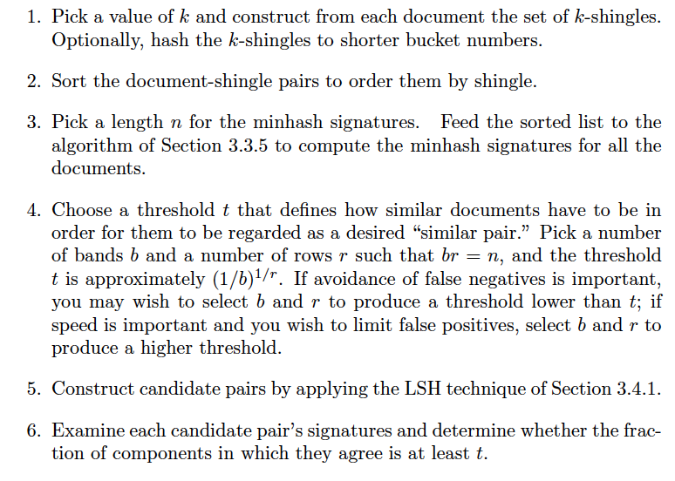
Combining all together: finding the set of candidate pairs for similar documents and then discovering the truly similar documents among them.

